Slide 1


Curie Point Depth Mapping using PyCurious on Aeromagnetic Data

Slide 2




About Me
IZZUL QUDSI
Geoscientist at Horizon Perdana
http://horizon-perdana.co.id/
izzul.qudsi@gmail.com
By Horizon Perdana
@panjoel4

Slide 3
Outline
This session will cover:
Overview
Technical Background
PyCurious
Summary

Slide 4
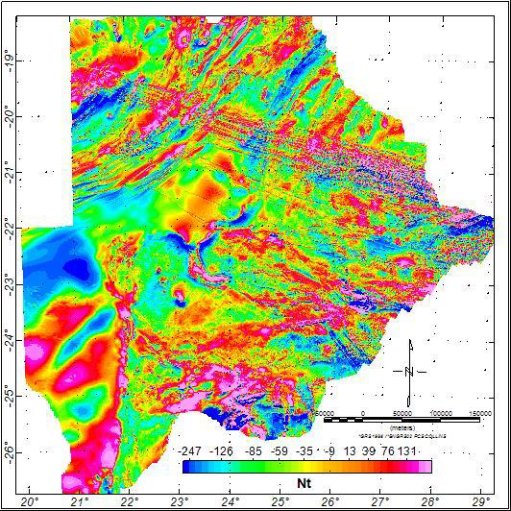

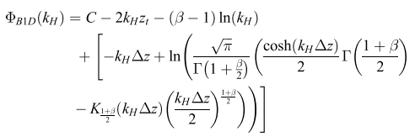
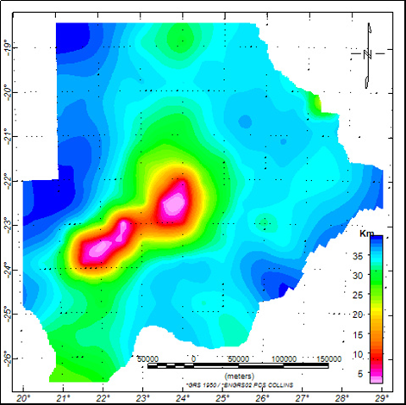

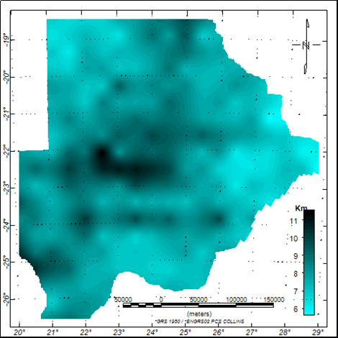
Overview
Curie Point Depth Mapping Underneath Botswana for Geothermal Prospect Identification Using Aeromagnetic Data

Slide 5
Background
Magnetic Data are the measurements of magnetic field intensity of Earth. These variations are based on the differences in magnetic minerals in Earth's crust. It can be used to indirectly infer differences in rock composition.
Curie Point Depth is the depth at which temperature reaches the value of Curie point of Magnetite (580 Celsius degree). It can be considered an index of the bottom of a magnetic source, due to ferromagnetic minerals converting to paramagnetic minerals.
The motivation of this work was to provide another information for the geothermal exploration in the study area.

Slide 6
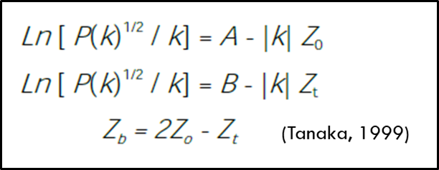
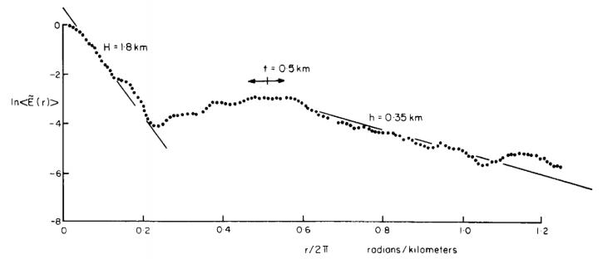
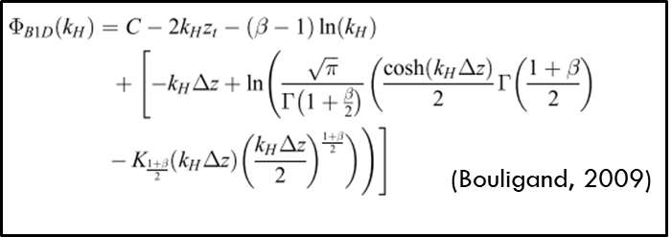
Background
H=∆z and h=zt
CPD = ∆z + zt
Estimate a single CPD value

Slide 7

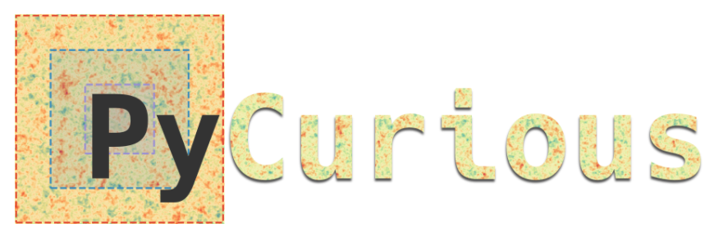

PyCurious
https://github.com/brmather/pycurious
About PyCurious
Created by Dr. Ben Mather.
Capable to calculate using Tanaka 1999 and Bouligand 2009
Produce the uncertainty the result
Full publication available here:
Mather, B. and Delhaye, R. (2019). PyCurious: A Python module for computing the Curie depth from the magnetic anomaly. Journal of Open Source Software, 4(39), 1544, https://doi.org/10.21105/joss.01544

Slide 8
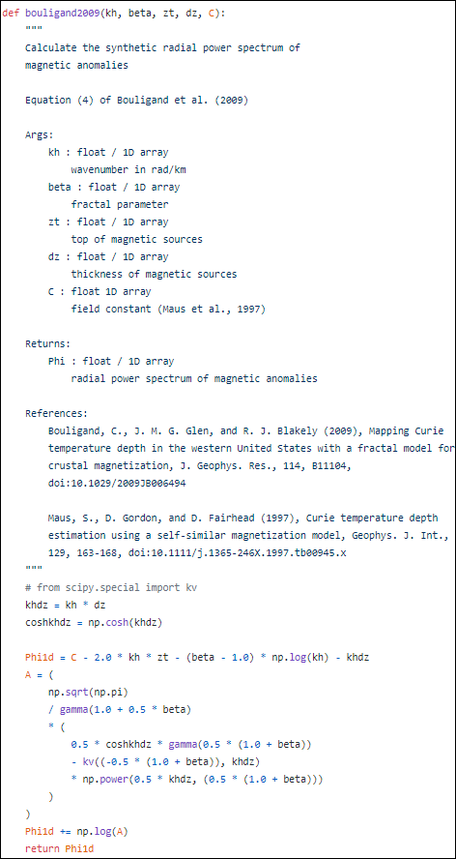

PyCurious
How to use it?
(Bouligand, 2009)

Slide 9
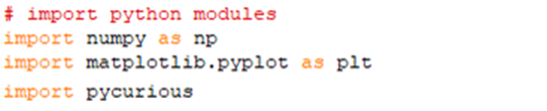
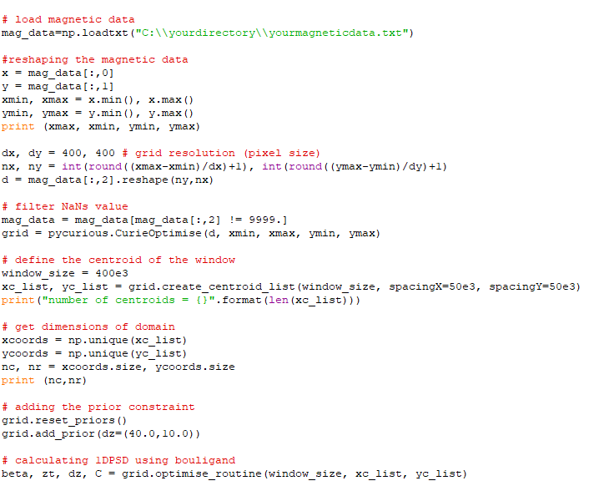
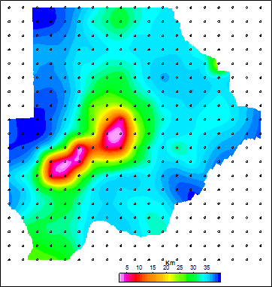
PyCurious

Slide 10
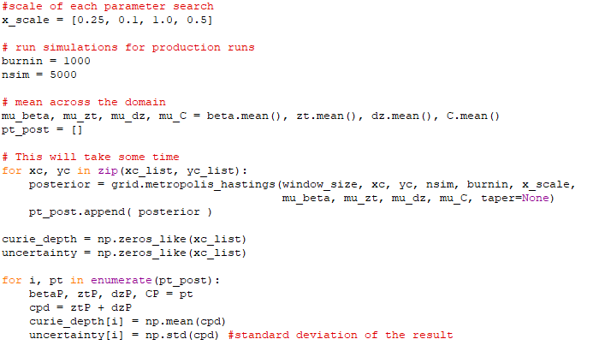
PyCurious
The Uncertainty
The uncertainty map is created from the standard deviation of each CPD calculation, generated using Markov Chain Monte Carlo method with Metropolis Hastings algorithm

Slide 11
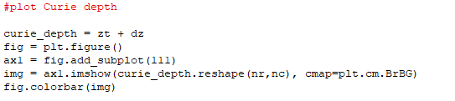
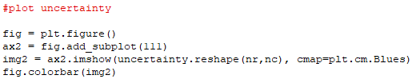
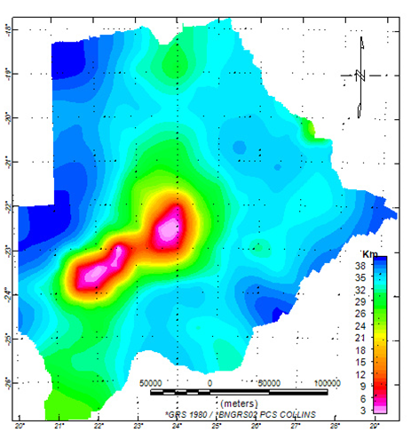
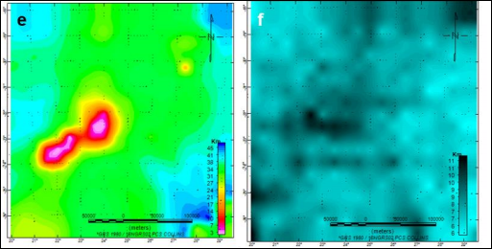
PyCurious

Slide 12
Summary
PyCurious was able to automatically estimate the CPD from hundreds of window subsets using the selected method.
PyCurious also produce the uncertainty using the Metropolis Hastings (Markov Chain Monte Carlo) algorithm

Slide 13
Thank you
@panjoel4
izzul.qudsi@gmail.com

